Slide 1
WELCOME
LangGo - Name of class

Slide 2
OBJECTIVES
01
02
INTRODUCTION
SYLLABUS
03
04
CLASSROOM RULES
LESSON 1

Slide 3

Introduction
Teacher
Students

Slide 4

GOALS
IELTS 3.0
WINNING HABITS

Slide 5
2.0 – 3.0 = ~ 150 hours
CLASS
HOME
20 lessons
2 hours/day
40 hours
~ 100 hours

Slide 6
CLASS
PRONUNCIATION
VOCABULARY
GRAMMAR
TEST

Slide 7
HOME – DAILY CHALLENGE
Exercise
Listening
Vocabulary

Slide 8
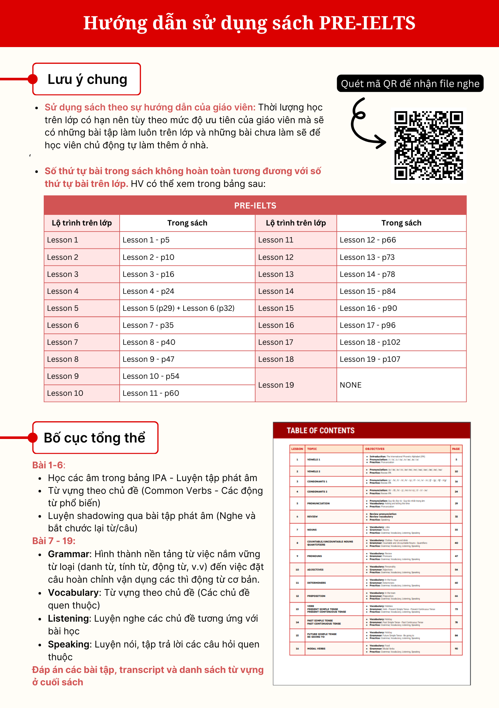

Slide 10
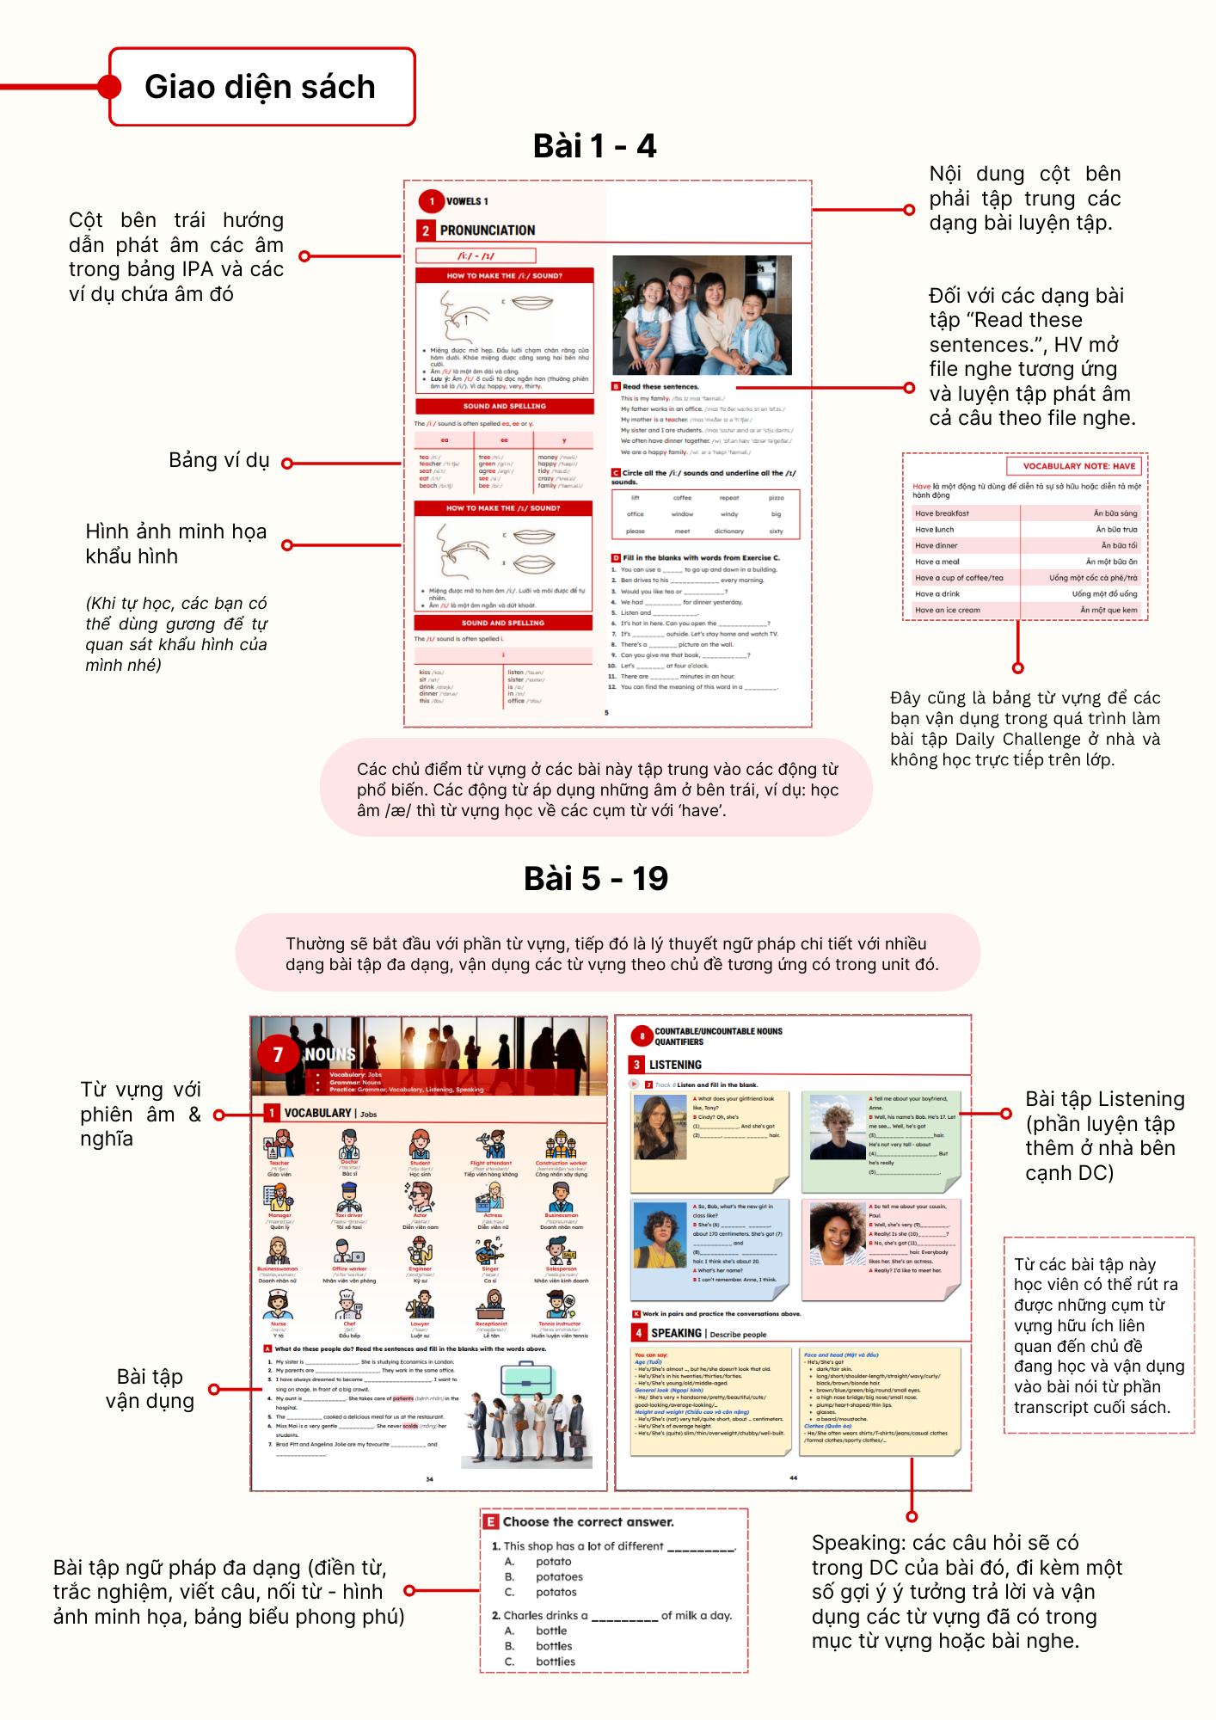

Slide 12
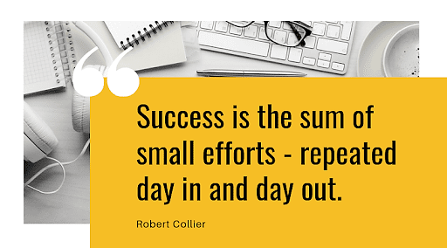

Slide 13
WINNING HABITS
Life-long learners: Học tập liên tục, phát triển không ngừng
Optimistic: Luôn lạc quan, nhìn thấy cơ hội trong mọi thử thách
Vigorous: Học nhiệt tình, 100% năng lượng
Empathetic: Chia sẻ, yêu thương, quan tâm, giúp đỡ
Disciplined: Kỷ luật, tự giác, NO excuses

Slide 14


Slide 15
Classroom rules
1.Be on time
2.Be interactive
3.100% or Nothing
4.Do all Daily Challenges

Slide 16
Tuân Thủ Nguyên Tắc Học Tập
(PRE-IELTS)
Tham gia ít nhất 90% buổi học/khóa (không quá 2 buổi nghỉ)
Hoàn thành đầy đủ và đúng deadline quy định ít nhất 90% lượng bài tập về nhà (thiếu và nộp muộn không quá 3 bài daily challenge)
Không quá 20% lượng bài tập không được tích sao ⭐ (không quá 7 bài không được tích sao)

Slide 17
Closing Circle

Slide 18
PRONUNCIATION

Slide 19
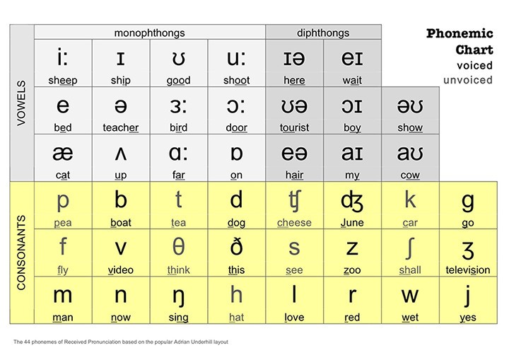
IPA: International Phonetic Alphabet

Slide 20
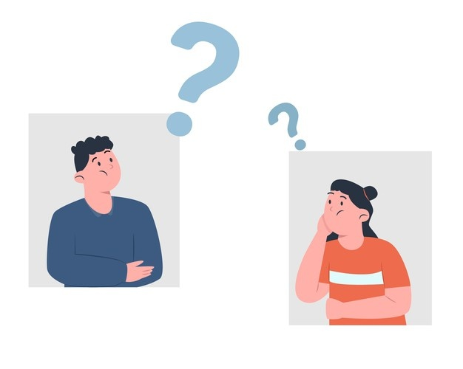
GUESS THE MEANINGS
44
24
20
12
8
2

Slide 21

GUESS THE MEANINGS
44: sounds in IPA chart
24: consonants
20: vowels
12: monophthongs
8: diphthongs
2: groups of consonants - voiced & unvoiced
2: groups of vowels - long & short vowels
2: main groups of IPA - Vowels & consonants

Slide 22
VOWELS

Slide 23
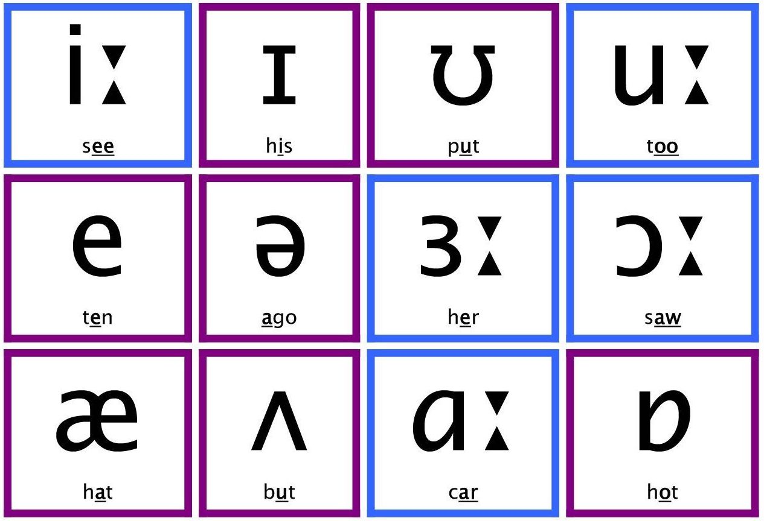
MONOPHTHONGS

Slide 24
/i:/ & /ɪ/

Slide 25




Sound /i:/
tree /tri:/
tea /ti:/
money
/ˈmʌni/
teacher
/ˈti:tʃə/
→ words with "ea", "ee", “-y"

Slide 26
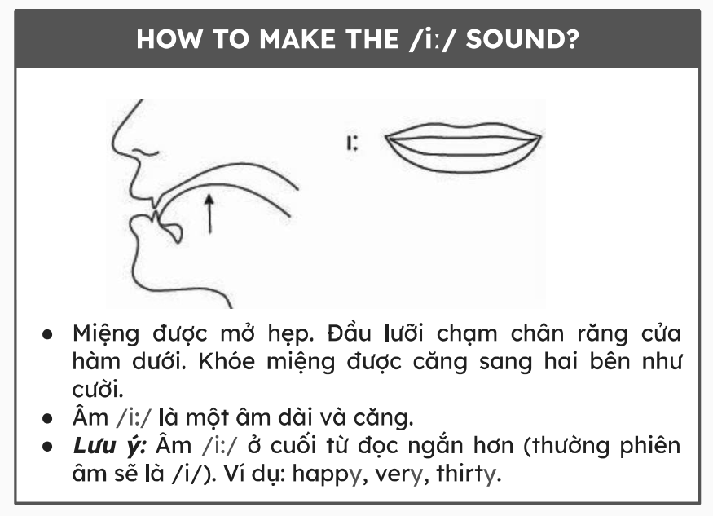

Slide 27
Sound /i:/
ee | ea | -y
green /griːn/ agree /əˈɡriː/ see /siː/ bee /biː/ | meat /ˈmiːt/ seat /siːt/ eat /iːt/ beach /biːtʃ/ | happy /ˈhæp.i/ tidy /ˈtaɪ.di/ crazy /ˈkreɪ.zi/ family /ˈfæm.əl.i/

Slide 28



Sound /ɪ/
kiss /kɪs/
sit /sɪt/
pin /pɪn/
→ words with only "i"

Slide 29
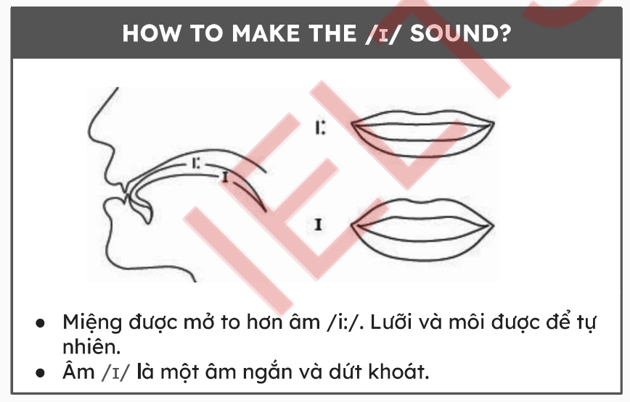

Slide 30
Sound /ɪ/
i
kiss /kɪs/ sit /sɪt/ drink /drɪŋk/ dinner /ˈdɪn.ə/ this /ðɪs/ | listen /ˈlɪs.ən/ sister /ˈsɪstər/ is /ɪz/ in /ɪn/ office /ˈɔfɪs/

Slide 31
Exercise: Read these sentences.
This is my family. /ðɪs ɪz maɪ ˈfæməli./
My father works in an office. /maɪ ˈfɑːðər wɜrks ɪn ən ˈɒf.ɪs./
My mother is a teacher. /maɪ ˈmʌðər ɪz ə ˈtiːtʃər./
We are a happy family. /wiː ər ə ˈhæpi ˈfæməli./
Notes:
Student’s book - ex.B page 5

Slide 32
/u:/ & /ʊ/

Slide 33



Sound /u:/
moon /mu:n/
group /gru:p/
true /tru:/
→ words with “oo“, “ou”, “ue”

Slide 34
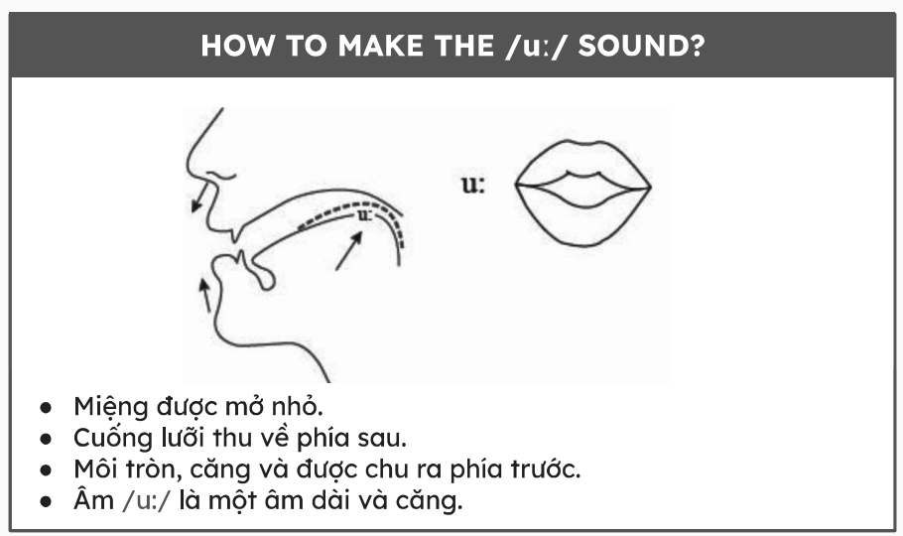

Slide 35
Sound /u:/
oo | ou | ue | ew
food /fuːd/ balloon /bəˈluːn/ school /skuːl/ cool /kuːl/ | group /gruːp/ soup /suːp/ route /ruːt/ through /θruː/ | true /truː/ clue /kluː/ blue /bluː/ glue /gluː/ | stew /stuː/ crew /kruː/ flew /fluː/ grew /gruː/

Slide 36



Sound /ʊ/
put /put/
look /lʊk/
should /ʃʊd/
→ words with “oo“, “u”, “ou”

Slide 37
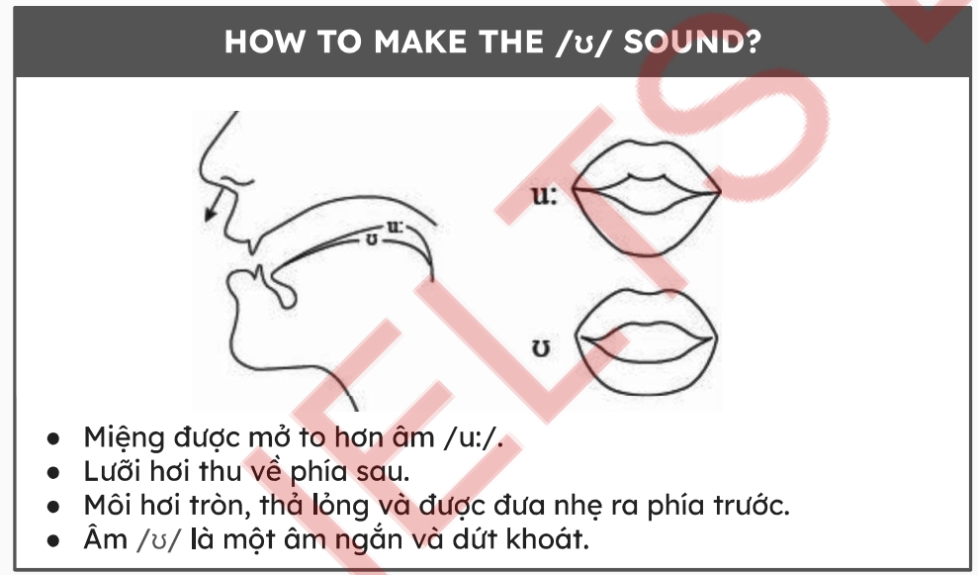

Slide 38
Sound /ʊ/
oo | ou | u
book /bʊk/ foot /fʊt/ good /gʊd/ cook /kʊk/ | should /ʃʊd/ would /wʊd/ could /kʊd/ | put /pʊt/ sugar /ˈʃʊɡ.ər/ cushion /ˈkʊʃ.ən/

Slide 39
Exercise 4: Read these sentences.
Every morning, I have noodles for breakfast.
/ˈevri ˈmɔːnɪŋ, aɪ hæv ˈnuːdlz fɔr ˈbrekfəst./
Then, I go to school on foot.
/ðen, aɪ ɡoʊ tu skuːl ɒn fʊt./
I say good morning to my friends and read a book.
/aɪ seɪ ɡʊd ˈmɔːnɪŋ tu maɪ frendz ænd rid ə bʊk/
In the afternoon, I go home and cook dinner.
/ɪn ði æftərˈnuːn, aɪ ɡoʊ hoʊm ænd kʊk ˈdɪnər/
I often eat warm food like soup or stew.
/aɪ ˈɔfən iːt wɔːm fuːd laɪk suːp ɔr stjuː/
Notes:
Student’s book - ex.E page 6

Slide 40
/e/ & /æ/

Slide 41


Sound /e/
ten /ten/
hen /hen/
→ words with only "e"

Slide 42
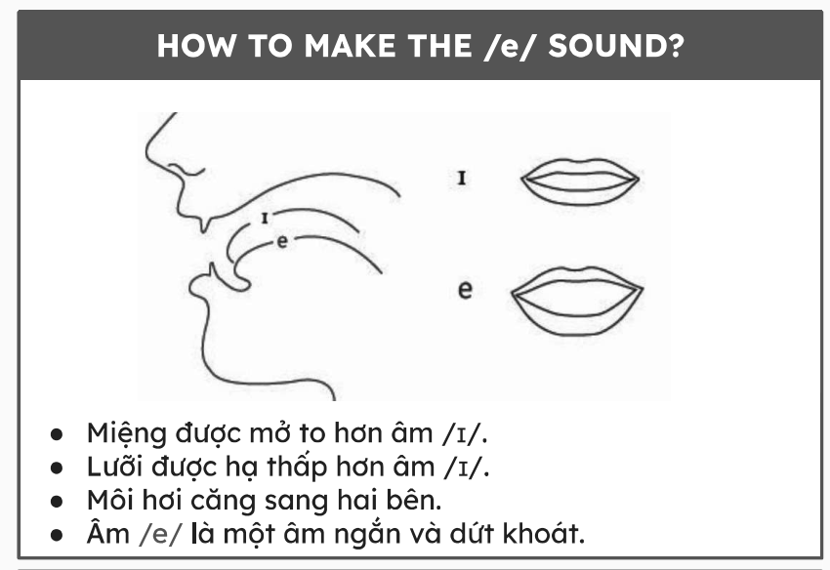

Slide 43
Sound /e/
e
yellow /ˈjeləʊ/ hen /hen/ men /men/ red /red/ | pen /pen/ bed /bed/ spell /spel/

Slide 44


Sound /æ/
hand /hænd/
hat /hæt/
→ words with only "a"

Slide 45
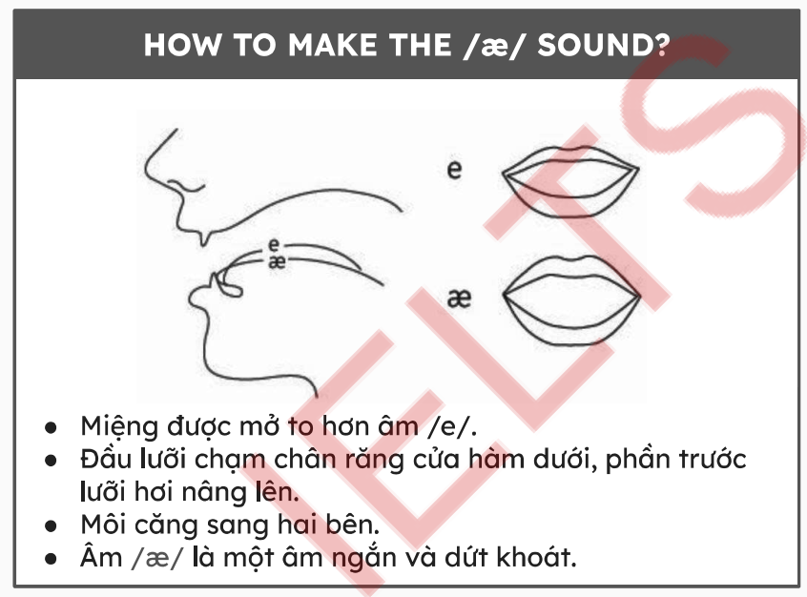

Slide 46
Sound /æ/
a
dad /dæd/ casual /ˈkæʒuəl / sandals /ˈsændəlz/ | black /blæk / pants /pænts/ backpack /ˈbækˌpæk/

Slide 47






Sound /e/
Sound /æ/
x
axe
pen
pan
men
man

Slide 48
/ɑ:/ & /ʌ/

Slide 49


Sound /ɑ:/
artist
/ˈɑːtɪst/
star
/stɑ:/
→ words with “ar"

Slide 50
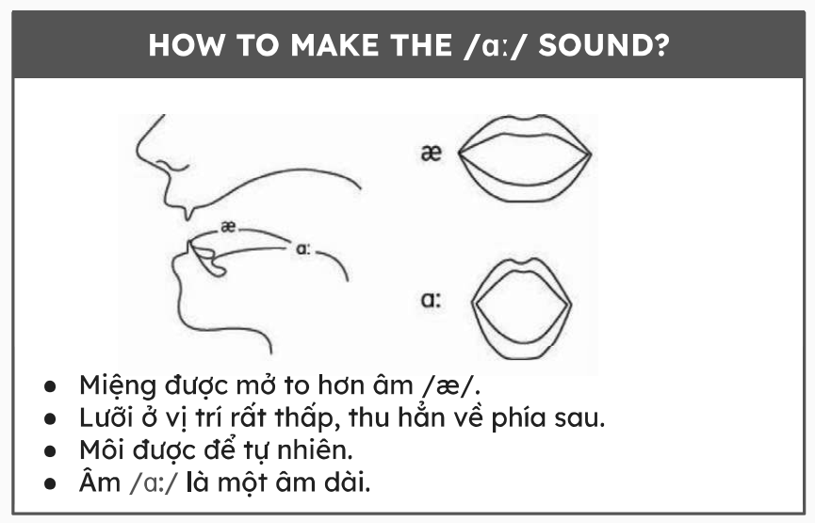

Slide 51
Sound /ɑ:/
ar
far /fɑːr/ car /kɑːr/ park /pɑːk/ | gardening /ˈɡɑːdənɪŋ/ dark /dɑːk/ backyard /ˈbækjɑːd/

Slide 52



Sound /ʌ/
cut
/kʌt/
love /lʌv/
tough
/tʌf/
→ words with “u“, “o”, “ou”

Slide 53
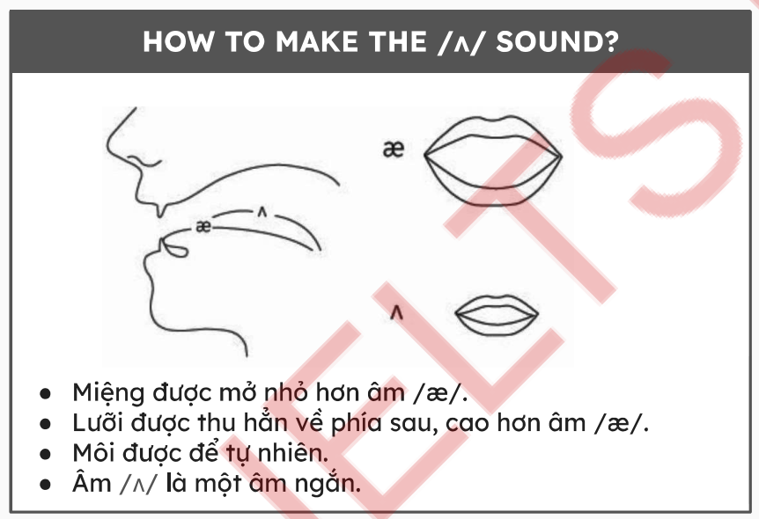

Slide 54
Sound /ʌ/
u | o | ou
run /rʌn/ lunch /lʌntʃ/ cucumber /ˈkjuːkʌmbə/ husband /ˈhʌz.bənd/ sunflower /ˈsʌnflaʊə/ | love /lʌv/ brother /ˈbrʌð.ər/ come /kʌm/ mother /ˈmʌð.ər/ son /sʌn/ | tough /tʌf/ country /ˈkʌn.tri/ couple /ˈkʌp.əl/ trouble /ˈtrʌb.əl/ young /jʌŋ/

Slide 55


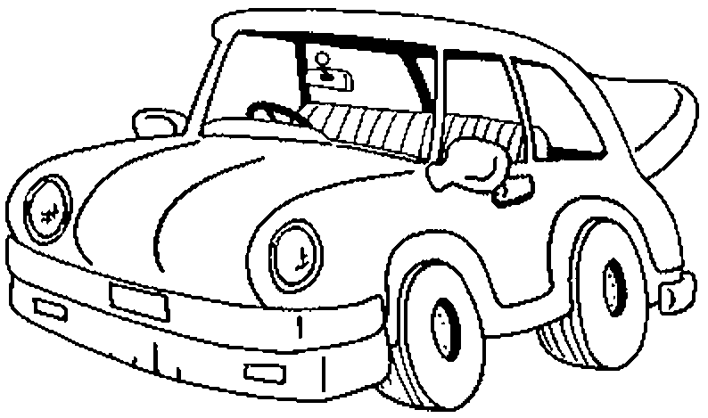

Sound /ɑ:/
Sound /ʌ/
Bar
/bɑː(r)/
Car
/kɑː(r)/
Bus
/bʌs/
Cup
/kʌp/

Slide 56
Exercise: Read these sentences.
I often do the gardening in my free time.
/aɪ ˈɒfən duː ðə ˈɡɑːdənɪŋ ɪn maɪ friː taɪm./
I grow cucumbers and sunflowers in my backyard.
/aɪ ɡrəʊ ˈkjuːkʌmbəz ænd ˈsʌnflaʊəz ɪn maɪ ˈbækjɑːd./
I also like to run with my husband.
/aɪ ˈɔːlsoʊ laɪk tuː rʌn wɪð maɪ ˈhʌzbənd./
We run around the park near our home.
/wiː rʌn əˈraʊnd ðə pɑːk nɪər aʊər həʊm./
Notes:
Student’s book - ex.I page 8

Slide 57
THANKS!

